Slide 1
Continuum College Financials
Stephanie Seo – Director of Finance
September 25, 2025

Slide 2
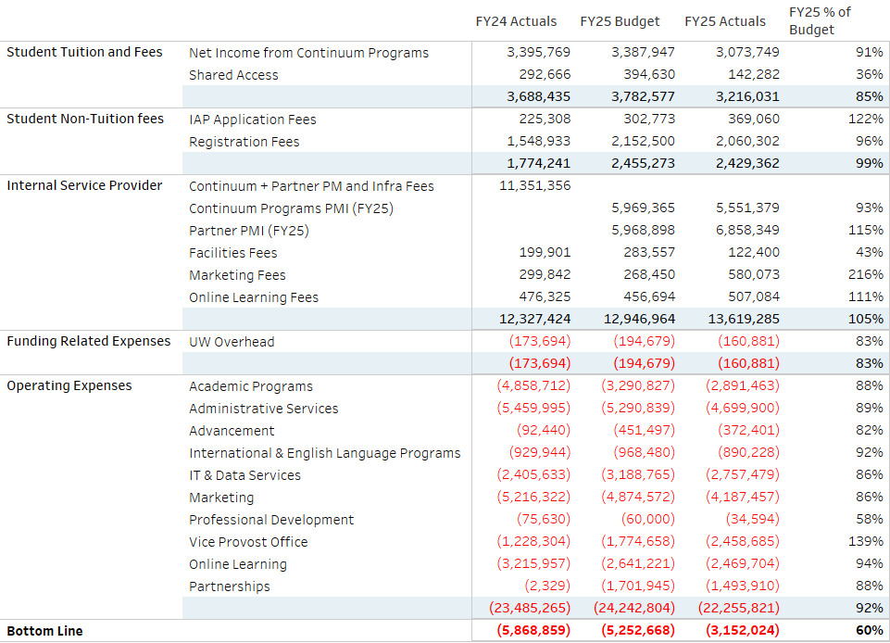

Slide 3
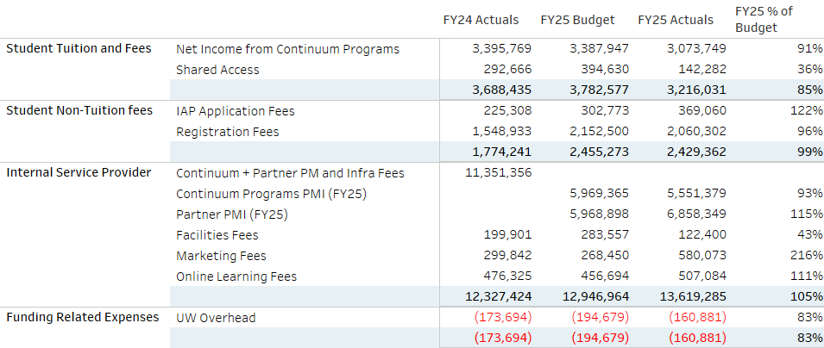
Funding Sources

Slide 4
Funding Sources

Slide 5
Funding Sources

Slide 6
Funding Sources

Slide 7
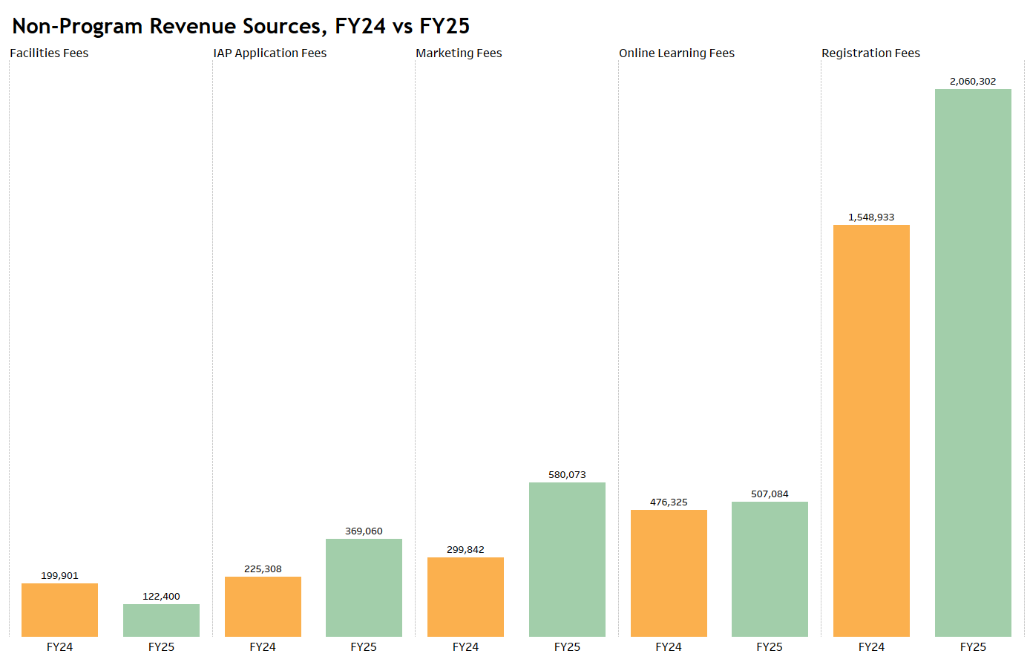

Slide 8
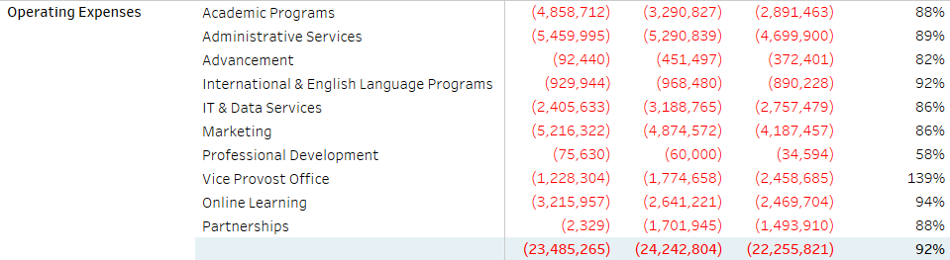
Operating/Admin Expenses

Slide 9
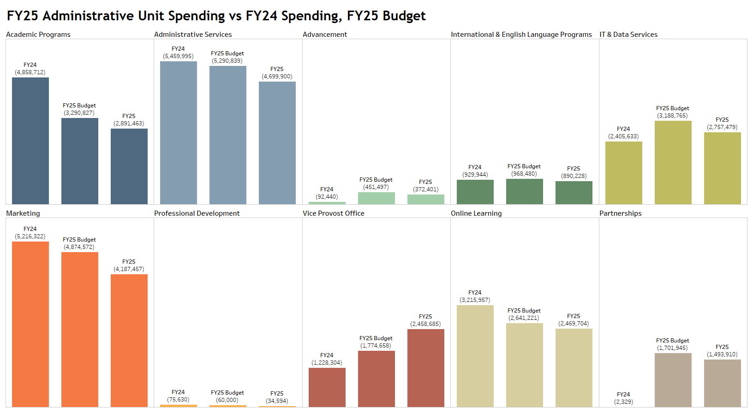

Slide 10
Executive Summary
FY24 Bottom Line: (5,868,859)
FY25 Budget: (5,252,668)

Slide 11
Thank you!
Questions?

